Slide 1


micro:bit robot entry tutorial
Lesson 5
micro:bit robot lesson 5 “Tracking”
YahBoom micro:bit video tutorial

Slide 2
micro:bit robot entry tutorial
Content
Part1
Part 2
Part3
Part 4
Part 5
Learning goals
Preparation
Search for blocks
Combine blocks
Attentions
YahBoom micro:bit video tutorial

Slide 3
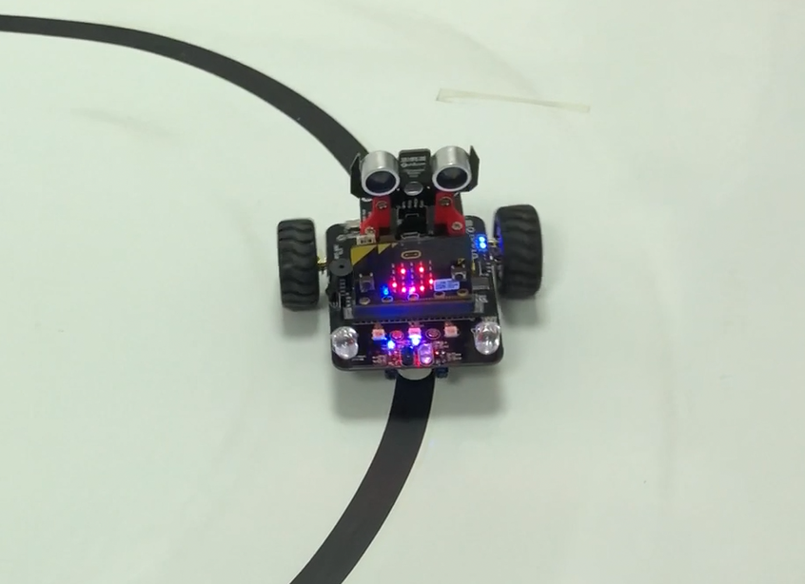
micro:bit robot entry tutorial
Part 1
Learning goals
Figure 1-1 tracking black line
Let's try this new robot game, robot tracking. We first use black tape to paste a circle on the white ground (also on white paper), and the robot will continue to patrol along the circle. Let's try the kids together.
YahBoom micro:bit video tutorial

Slide 4
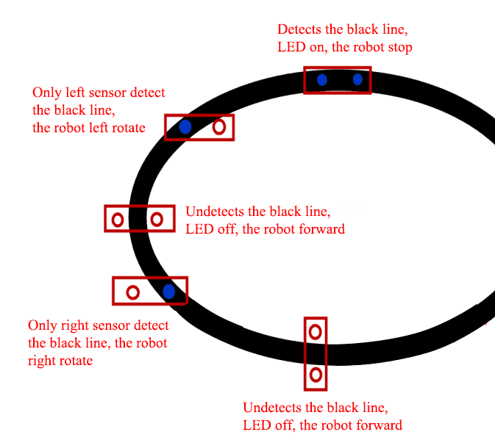
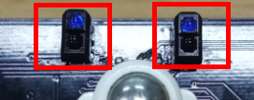
micro:bit robot entry tutorial
Part2
Figure 1-2 tracking module
Principle
The basic principle of infrared sensors is to take advantage of the reflective properties of the object. This experiment is traveling on the black line. When the infrared emission is on the black line, it will be absorbed by the black line, and the materials emitted to the other colors will be reflected on the infrared receiver. When the car's patrol module detects the black line, the indicator light is on. When the white object is detected, the indicator lights go out. We write the corresponding code according to this difference to complete the car patrol line function.
YahBoom micro:bit video tutorial

Slide 5
micro:bit robot entry tutorial
Part 2
Hardware:
● 1 X USB cable
● 1 X micro:bit robot
Preparation
Then the micro:bit is connected to the computer through USB, and the computer will pop up a U disk and click the URL in the U disk to enter the programming interface. Input this URL https://github.com/lzty634158/yahboom_mbit_en to get the package.
YahBoom micro:bit video tutorial

Slide 6
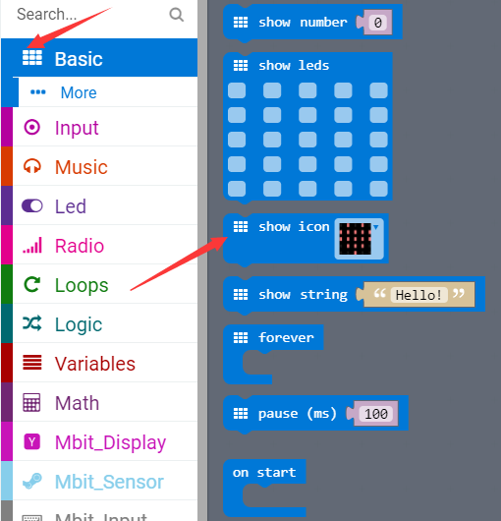
micro:bit robot entry tutorial
Part 3
Search for blocks
YahBoom micro:bit video tutorial

Slide 7
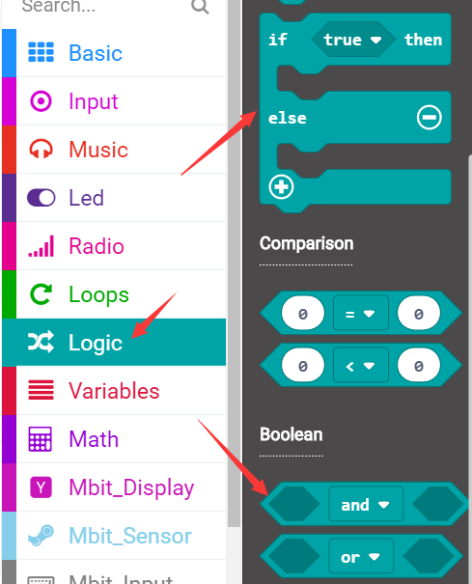
micro:bit robot entry tutorial
Part 3
Search for blocks
YahBoom micro:bit video tutorial

Slide 8
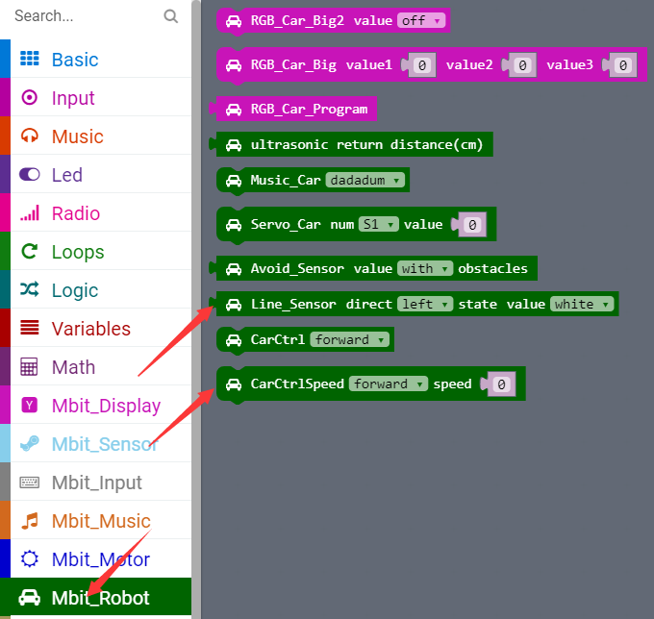
micro:bit robot entry tutorial
Part 3
Search for blocks
YahBoom micro:bit video tutorial

Slide 9
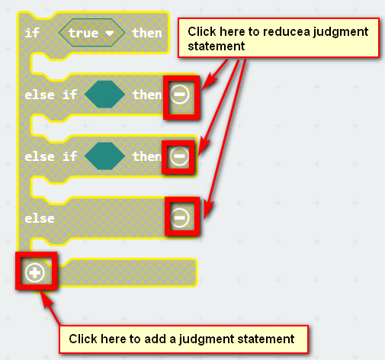
micro:bit robot entry tutorial
Part 3
Search for blocks
YahBoom micro:bit video tutorial

Slide 10
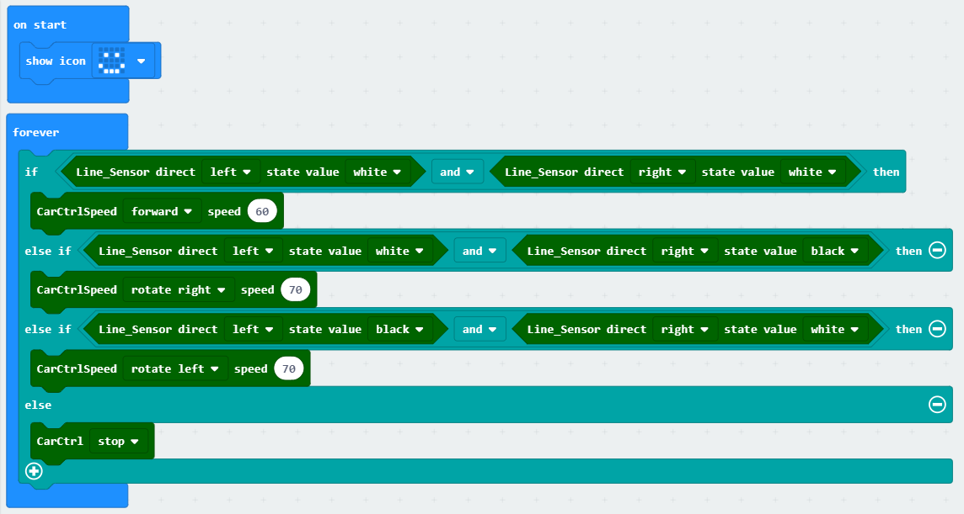
micro:bit robot entry tutorial
Part 4
Combine blocks
YahBoom micro:bit video tutorial

Slide 11
micro:bit robot entry tutorial
Part 5
Attentions
This experiment must be carried out indoors to reduce interference from sunlight to infrared receiver.
YahBoom micro:bit video tutorial

Slide 12
micro:bit robot entry tutorial
robot
lesson
Thanks for watching！
Powered by YahBoom
YahBoom micro:bit video tutorial

